Slide 1
Bayesian cognitive and statistical modeling applied to Signal Detection Theory and the Mirror Effect in a perceptual task

Slide 2
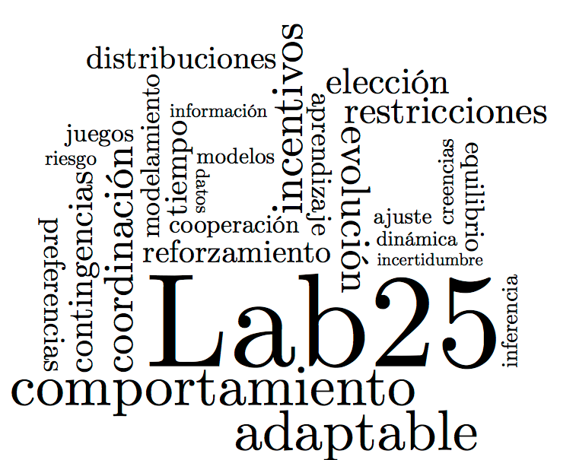
Introduction

Slide 3
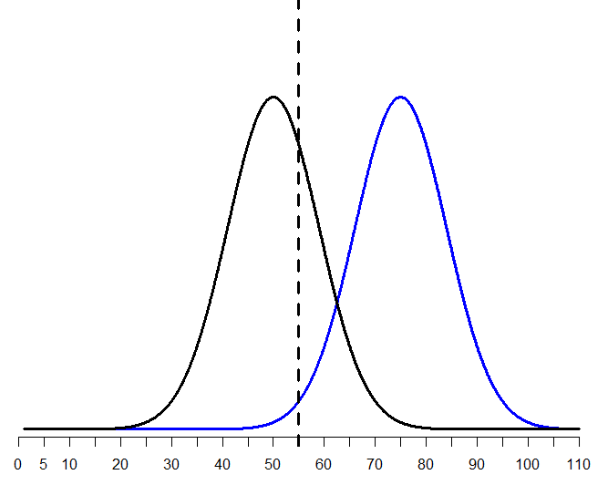
Signal Detection Theory

Slide 4
Recognition Memory
Study Phase
Can be presented as…
Intentional (participants are asked to memorize/study the stimuli)
Incidental (participants are told to interact with the stimuli)
Recognition task
“Was this particular stimulus a part of the set of stimuli previously presented?”

Slide 5
The Mirror Effect

Slide 6
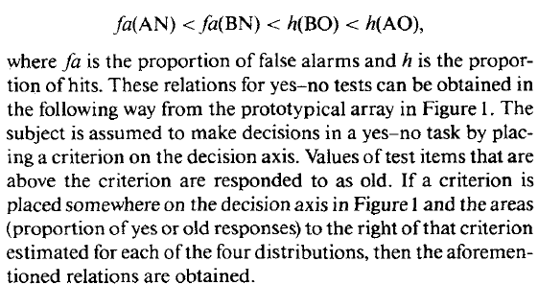
Which means that for the classical SDT binary task…

Slide 7
First Question
Is the Mirror Effect a

Slide 8
Method

Slide 9
Results: Did we replicate the effect?

Slide 10
A) Replication of the analysis reported in the M.E. literature
1.- Make sure that d’(A) > d’(B)
2.- Comparing the Hit and F.A. rates to test the M.E. pattern of response
3.- Comparing the Mean confidence ratings assigned to each class of stimuli.

Slide 11
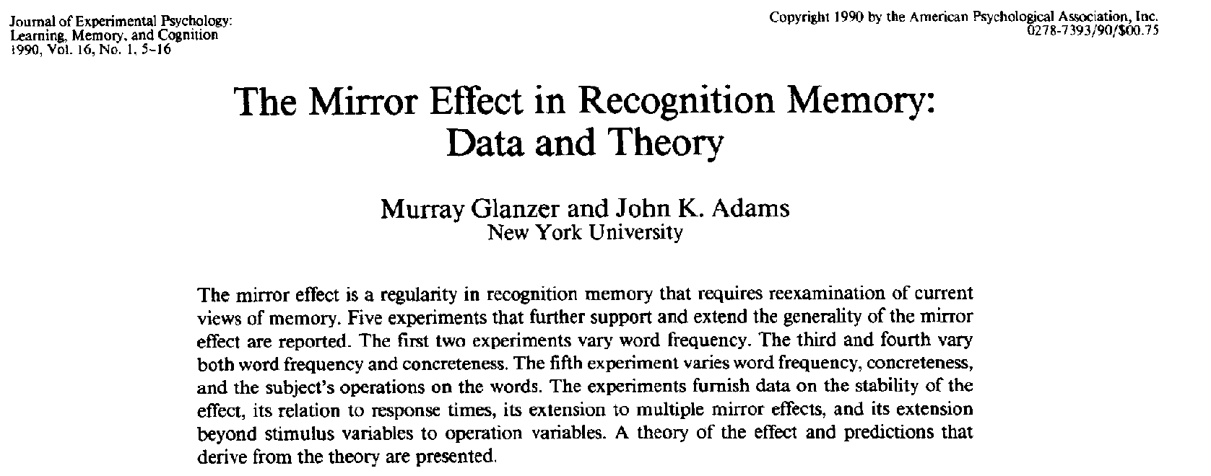
A) Replication of the analysis reported in the M.E. literature
Our replication was done step-by-step as reported in:
2.- Comparing the Hit and F.A. rates to test the M.E. pattern of response
Computing the Hit and F.A. rate per participant and do an arcsine transformation
3.- Comparing the Mean confidence ratings assigned to each class of stimuli.

Slide 12
A) Replication of the analysis reported in the M.E. literature
1.- Make sure that d’(A) > d’(B)
Calculate d’ for each class of stimuli, per participant
t-test!
2.- Comparing the Hit and F.A. rates to test the M.E. pattern of response
3.- Comparing the Mean confidence ratings assigned to each class of stimuli.

Slide 13
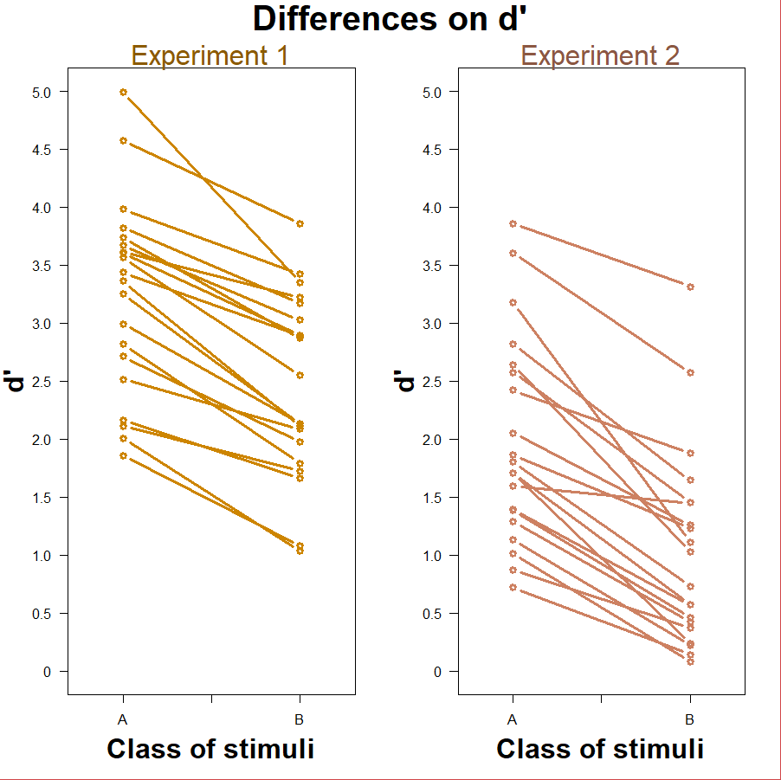
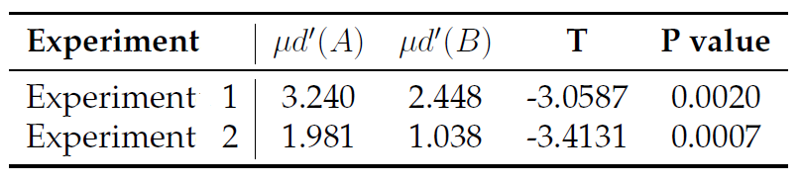
Making sure d’(A) > d’(B)

Slide 14
A) Replication of the analysis reported in the M.E. literature
1.- Make sure that d’(A) > d’(B)
2.- Comparing the Hit and F.A. rates to test the M.E. pattern of response
Compute the Hit and F.A. rates per participant and apply an arcsine transformation
Compare Hit rates and F.A. rates with two different t-tests!
3.- Comparing the Mean confidence ratings assigned to each class of stimuli.

Slide 15
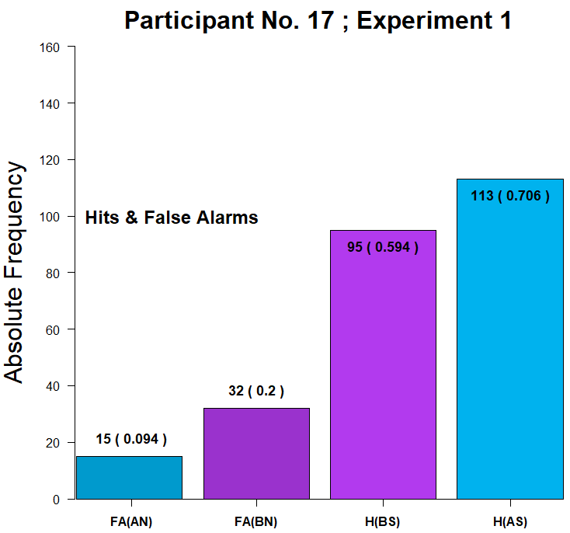
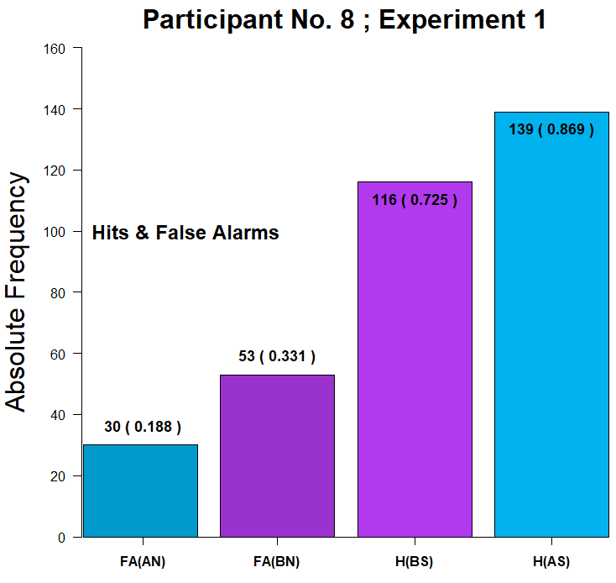
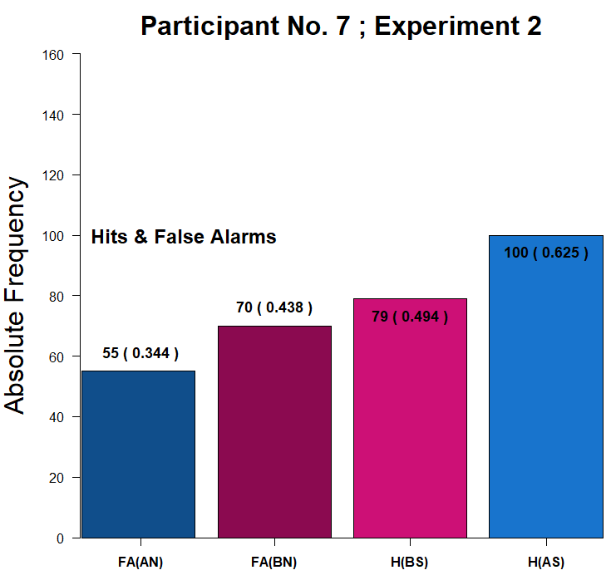
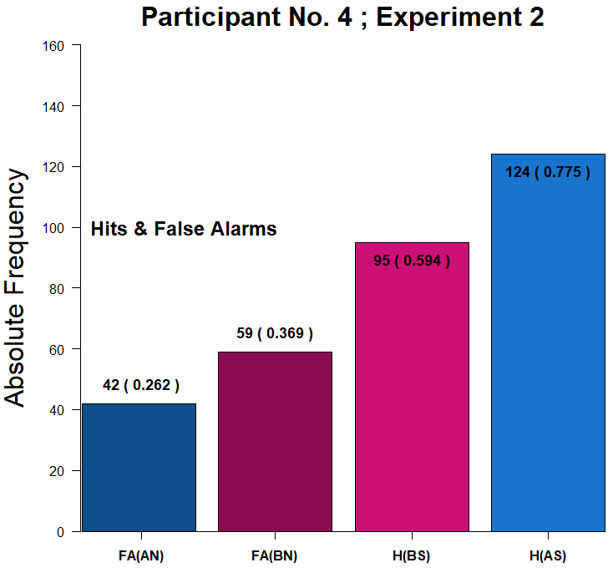
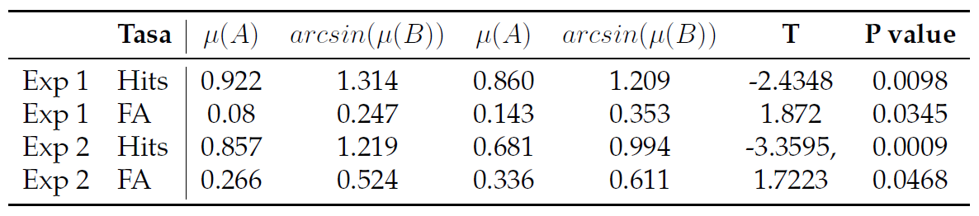
F(A) < F(B) < H(B) < H(A)

Slide 16
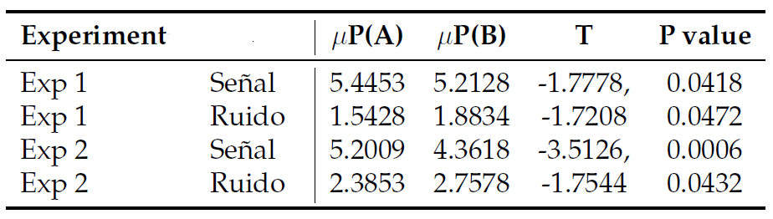
A) Replication of the analysis reported in the M.E. literature
1.- Make sure that d’(A) > d’(B)
2.- Comparing the Hit and F.A. rates to test the M.E. pattern of response
3.- Comparing the Mean confidence ratings assigned to each class of stimuli.

Slide 17
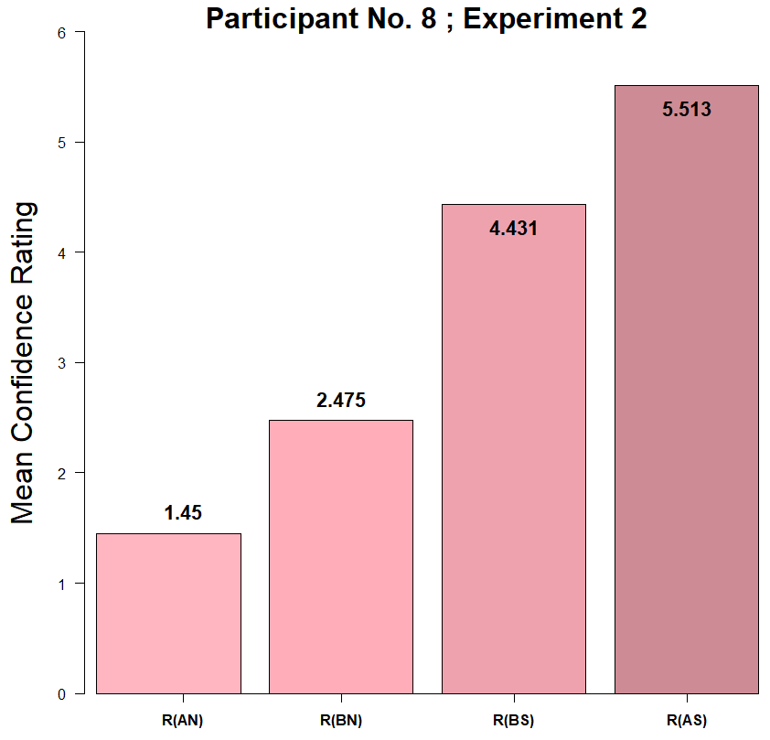
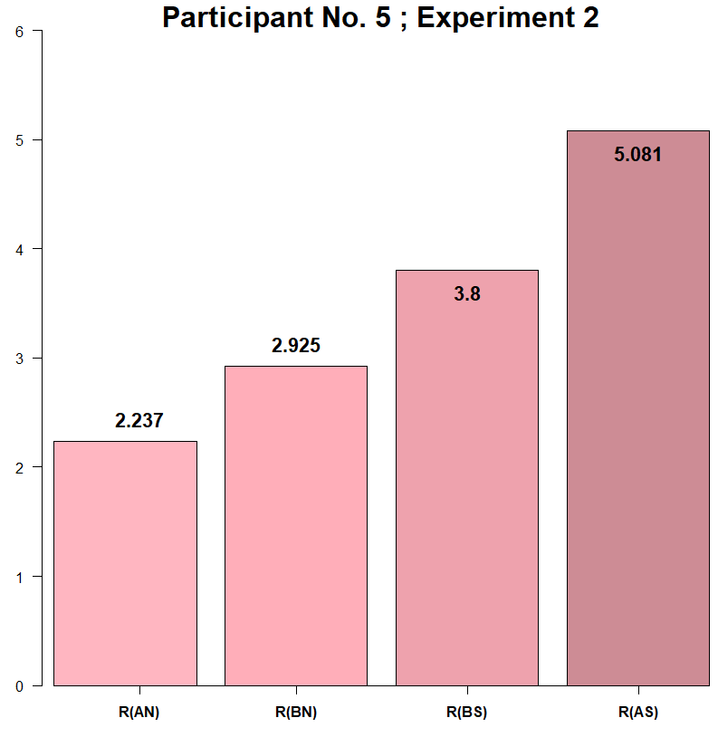
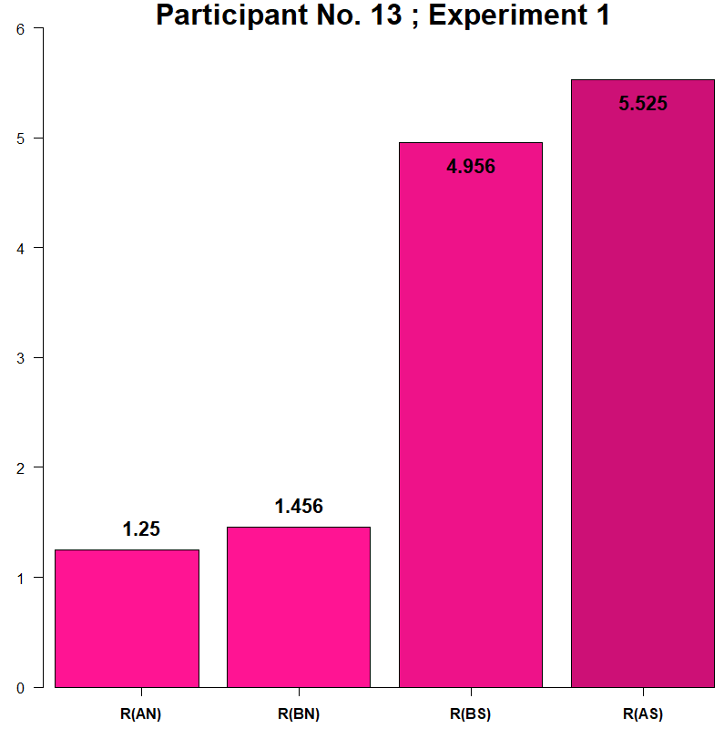
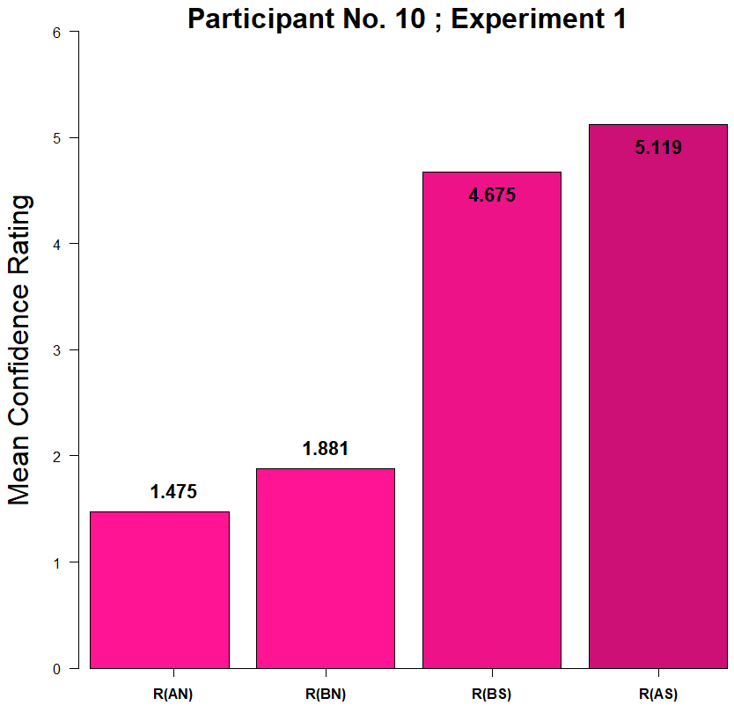
R(NoA) < R(NoB) < R(YesB) < R(YesA)

Slide 18
Bayesian cognitive models

Slide 19
1. Making sure d’(A) > d’(B)
In order to make our results comparable to what has been reported on the literature of the Mirror Effect withing Recognition Memory, we have to be able to guarantee that our two clases of stimuli are indeed different in terms of how “difficult” they are.

Slide 20
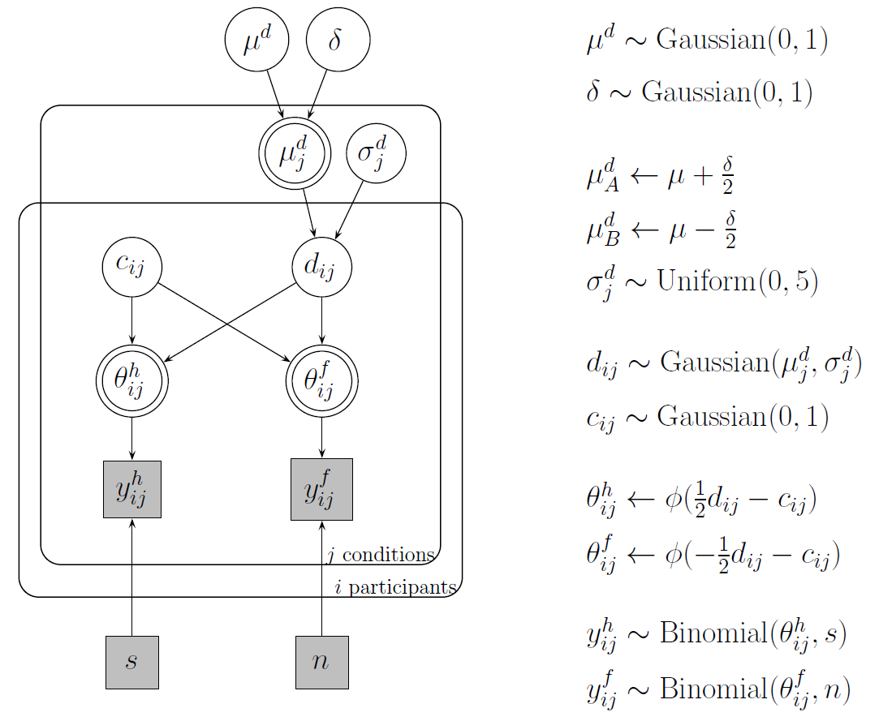

Slide 21
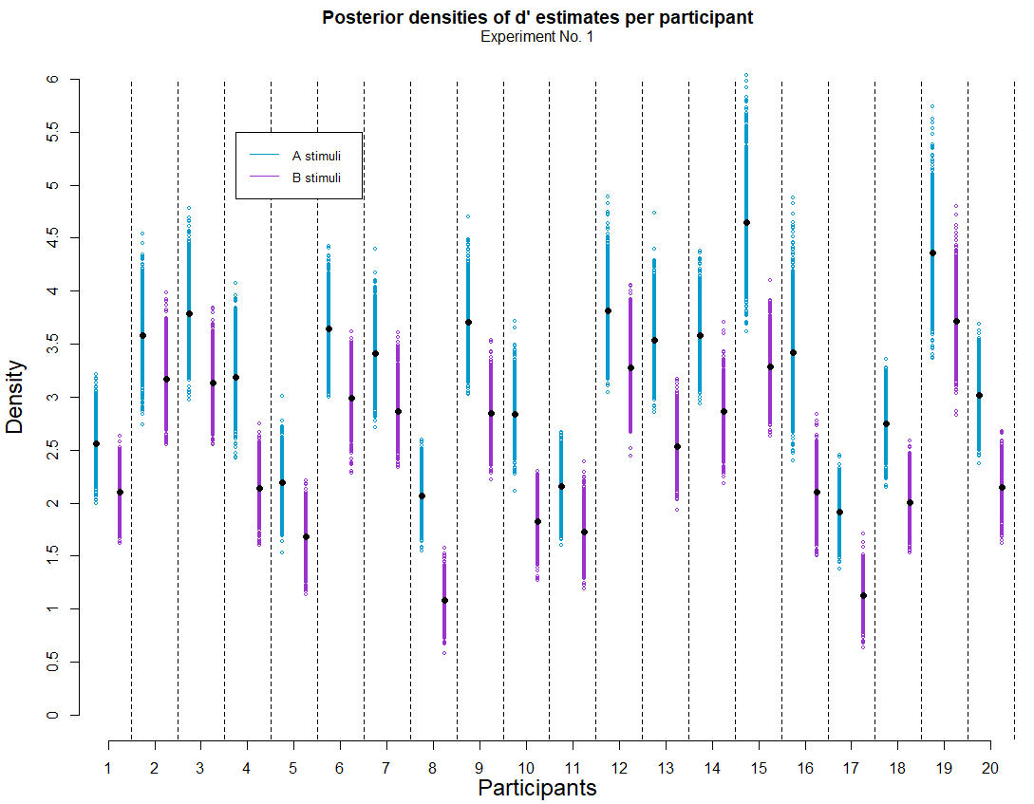
Plot 1
What’s important about this plot?
For all participants, d’ estimates are greater for A class stimuli than for B class.
Notes:
PS: Alex suggested me to use this kind of plot and I really liked it.

Slide 22
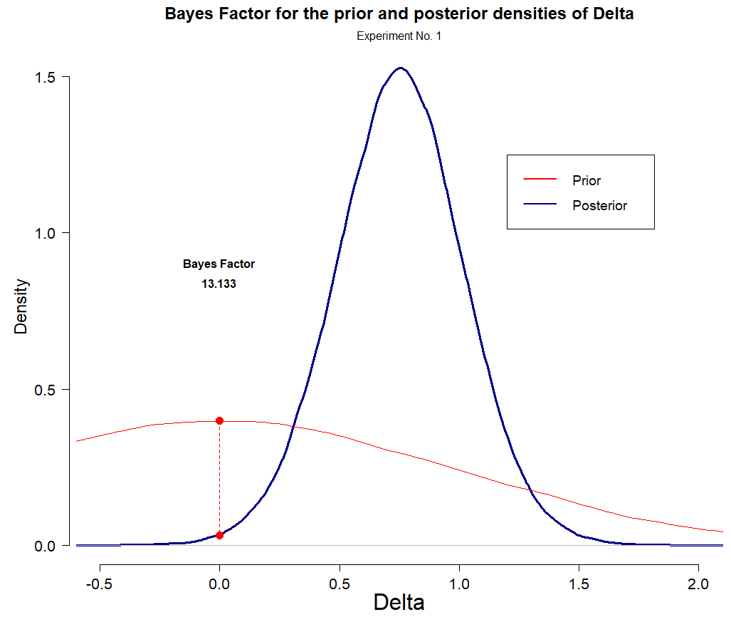
Plot 2
What’s important about this plot?
According to the Bayes Factor, the posterior estimates suggest that it’s 13 times lees likely that the difference between d’ across each class of stimuli is 0, than/from what had been stated on the prior.
Notes:
PS: Alex suggested me to use this kind of plot and I really liked it.

Slide 23
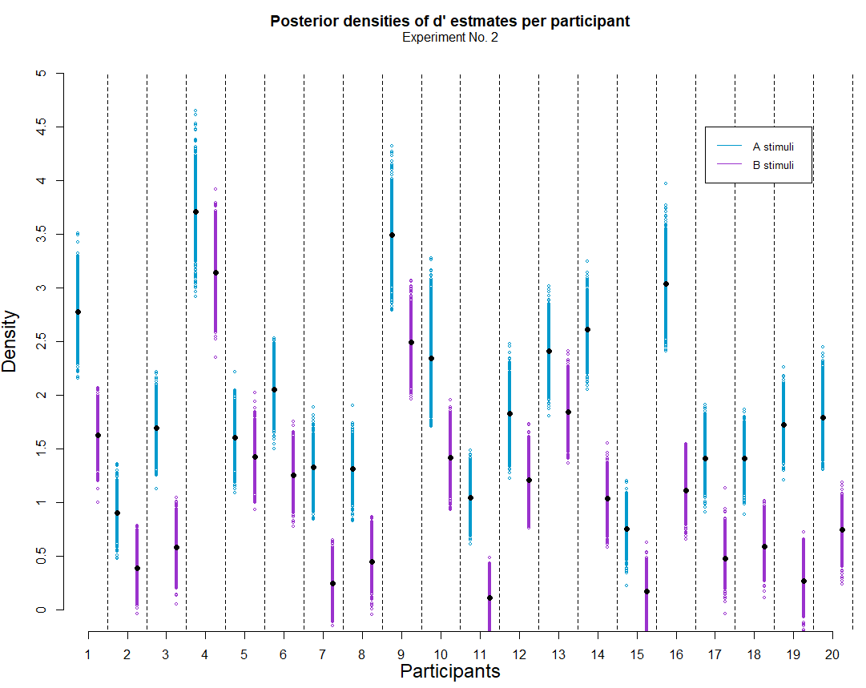
Plot 1
Same things happen in Experiment 2
For all participants, d’ estimates are greater for A class stimuli than for B class.
Notes:
PS: Alex suggested me to use this kind of plot and I really liked it.

Slide 24
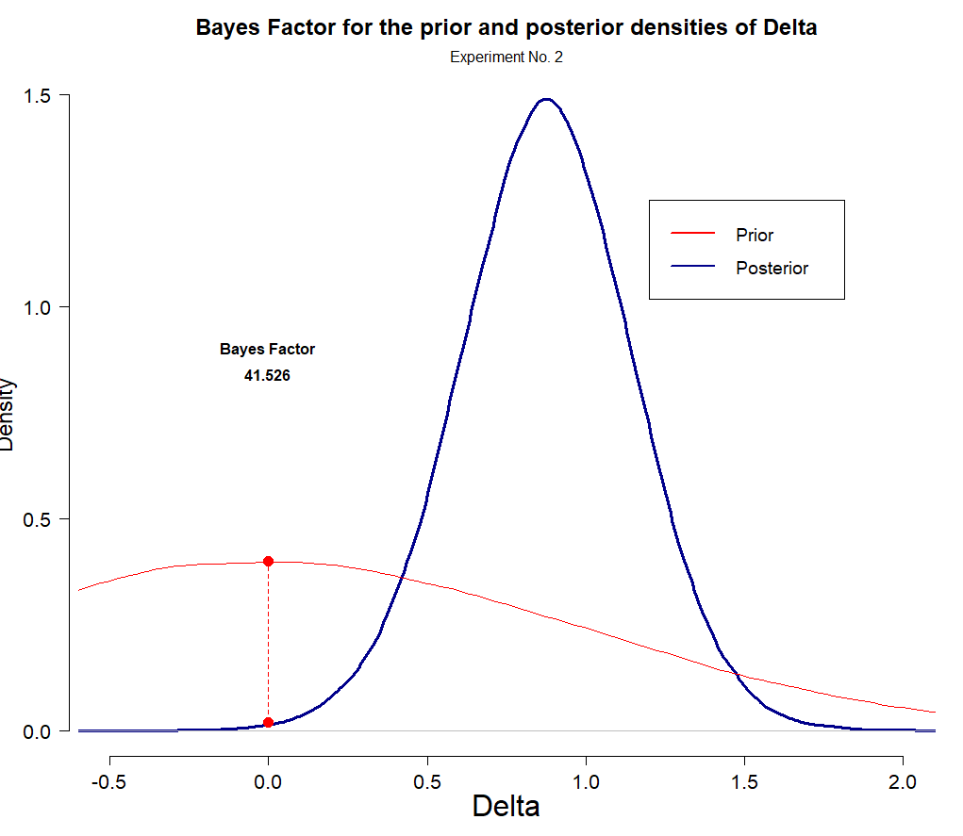
Plot 2
According to the Bayes Factor, the posterior estimates suggest that it’s 41.5 times lees likely that the difference between d’ across each class of stimuli is 0, than/from what had been stated on the prior.

Slide 25
2. Contaminant Bayesian modeling
In order to make our results comparable to what has been reported on the literatura of the Mirror Effect withing Recognition Memory, we have to be able to guarantee that our two clases of stimuli are indeed different in terms of how “difficult” they are.

Slide 26
2.1 A “simple” contaminant model
The experiment was programmed so that on each trial, participants could face a signal or noise trial from either class of stimuli completely at random.
Given the sturcture of the experiment, one would expect that “Yes” and “No” responses were registered with a fairly equal probability on each trial. We test this with a first mixture model for the plain “yes” “no” input registered by participants.

Slide 27
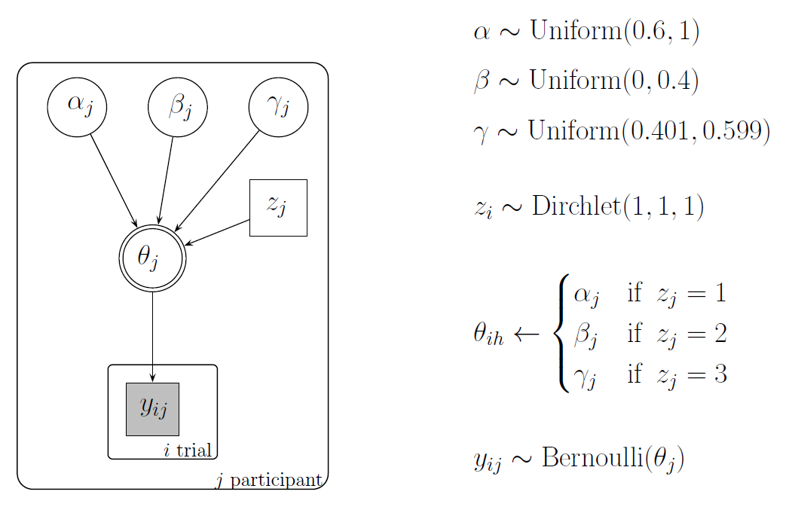

Slide 28
2.2 A “cognitive” contaminant model
A Mixture Model

Slide 29
3. Looking for the Mirror Effect
Comparing the Hit and F.A. rates across clases of stimuli to see if we can find the same pattern as the one reported in the literatura under the name of “the Mirror Effect”
FA(A) < FA(B) < H(B) < H(A)

Slide 30
3.1 Comparing binomial response rates

Slide 31
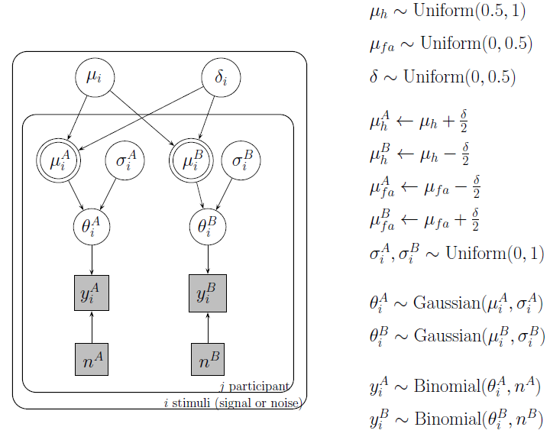

Slide 32
3.2 Comparing Hit rates and F.A. rates in the context of a Bayesian cognitive model
Using a Bayesian cognitive SDT model to look through the differences observed between the Hit and F.A. rates across clases of stimuli

Slide 33
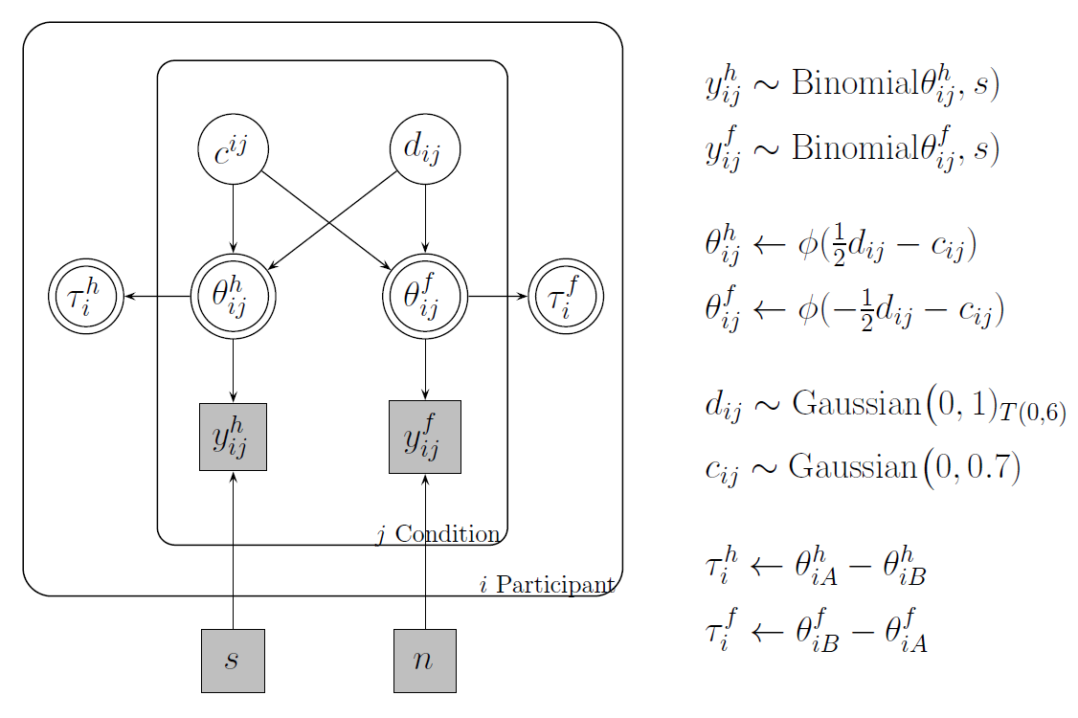

Slide 34
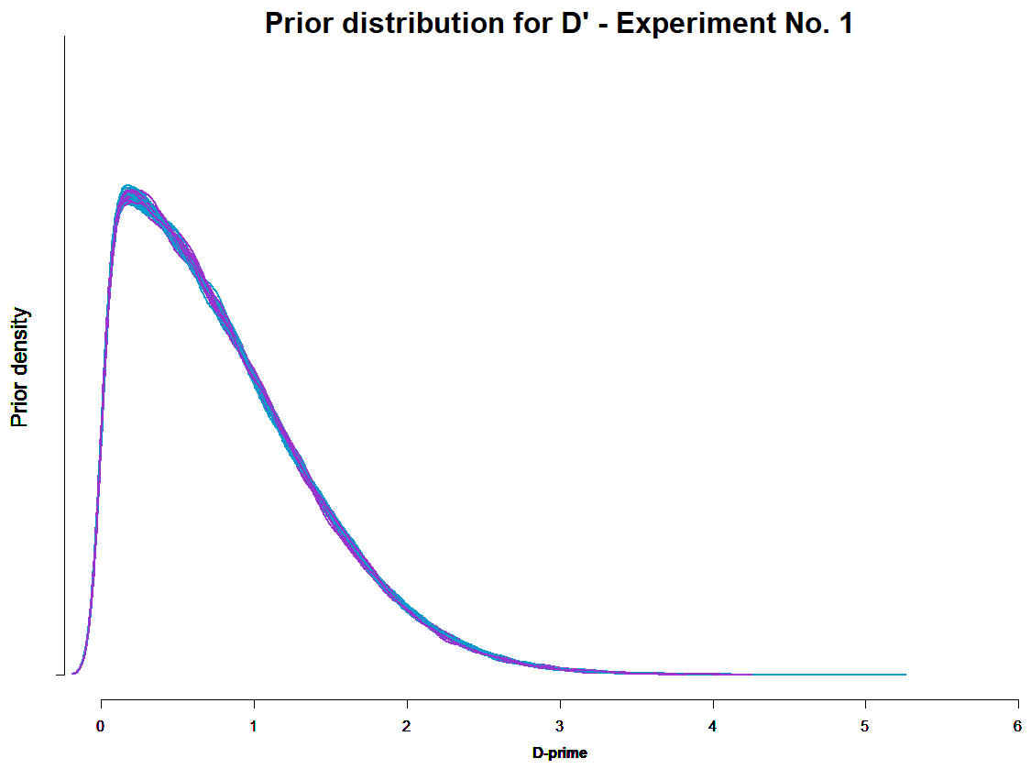
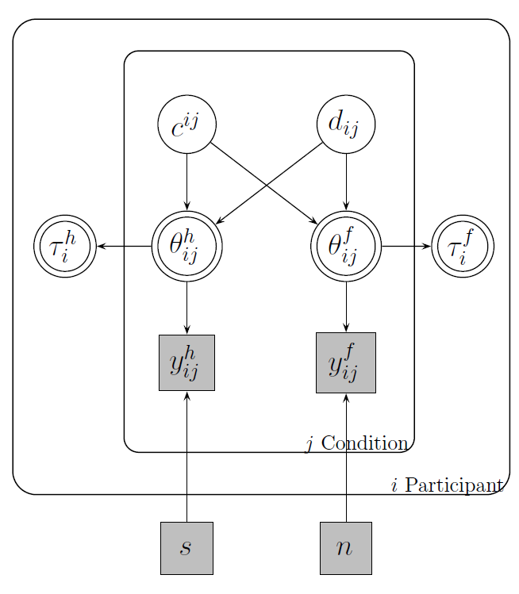
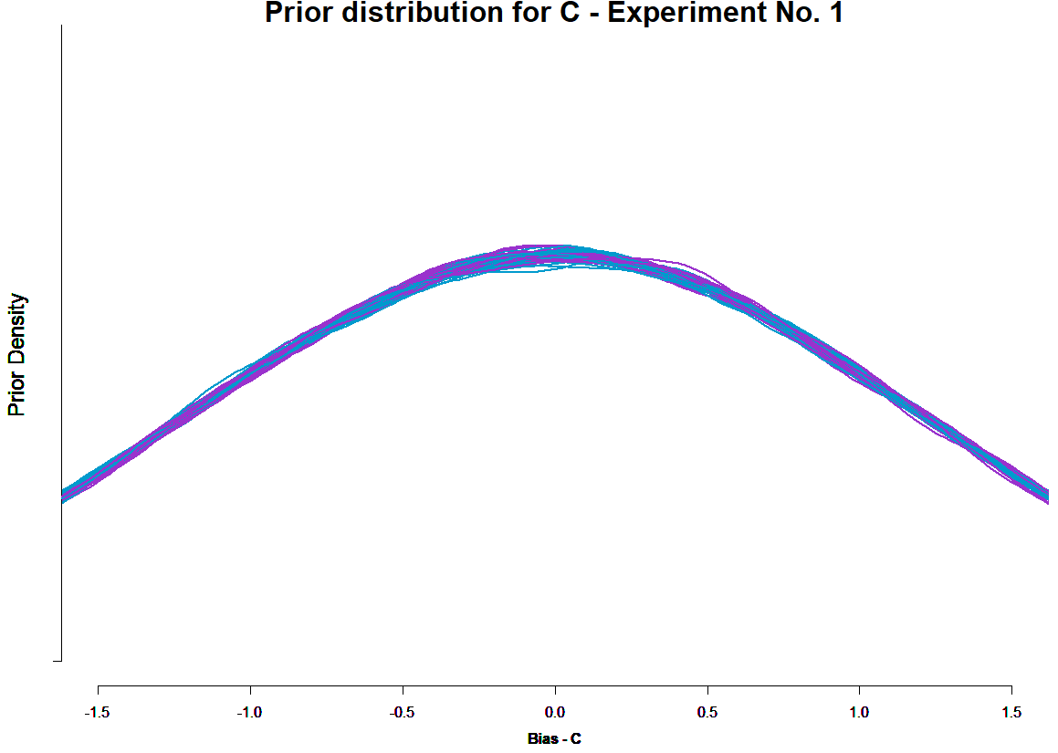

Slide 35
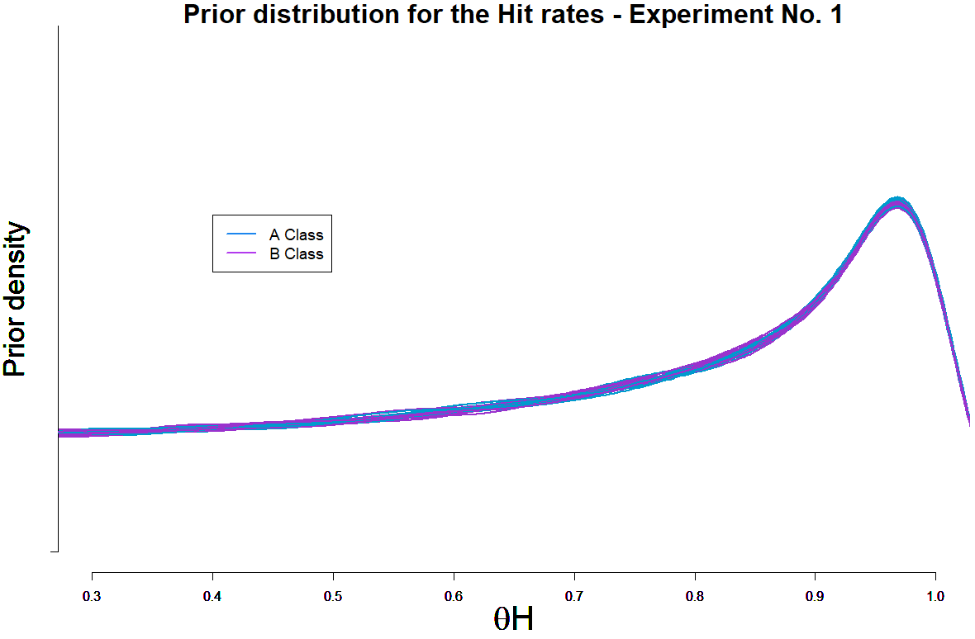
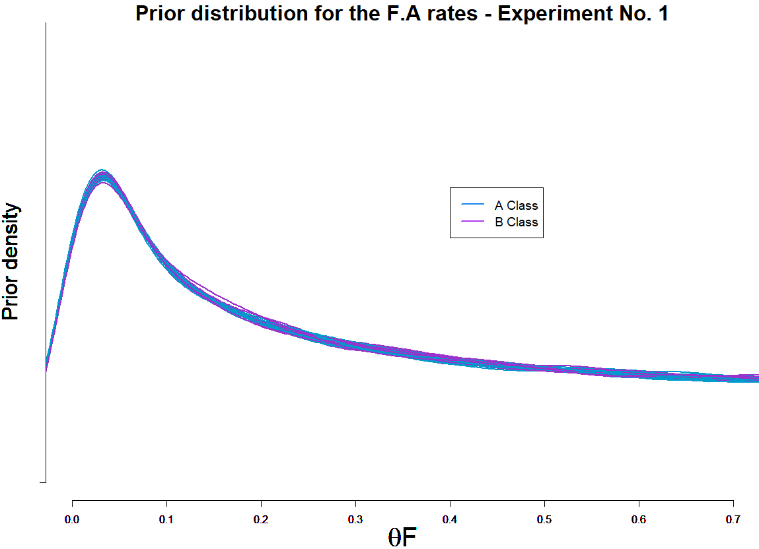

Slide 36
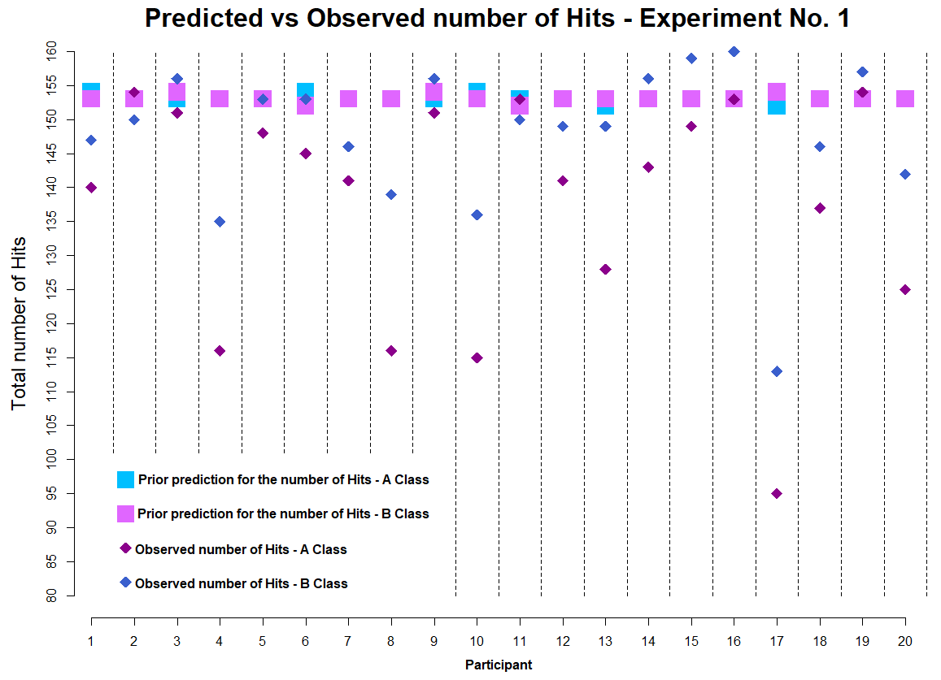
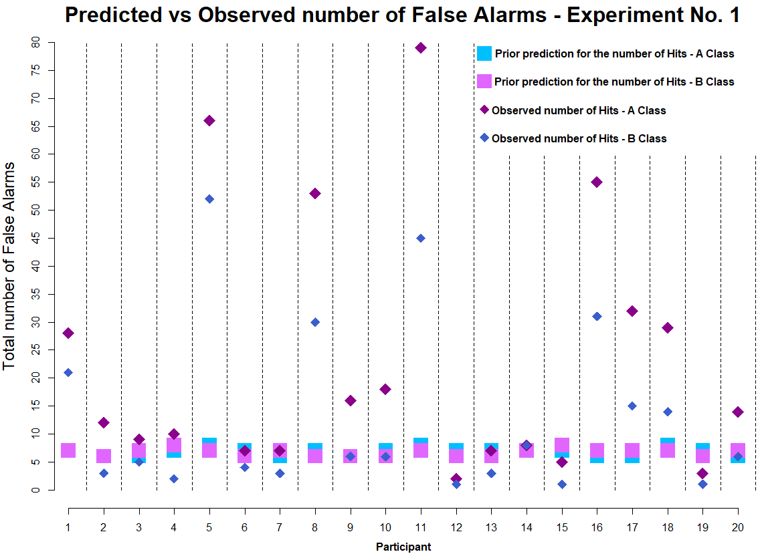

Slide 37
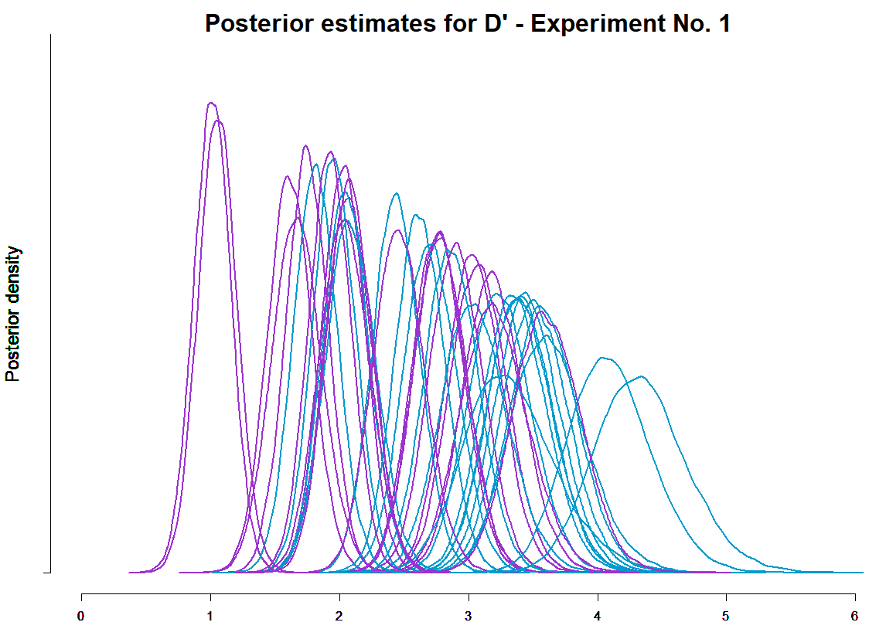

Slide 38
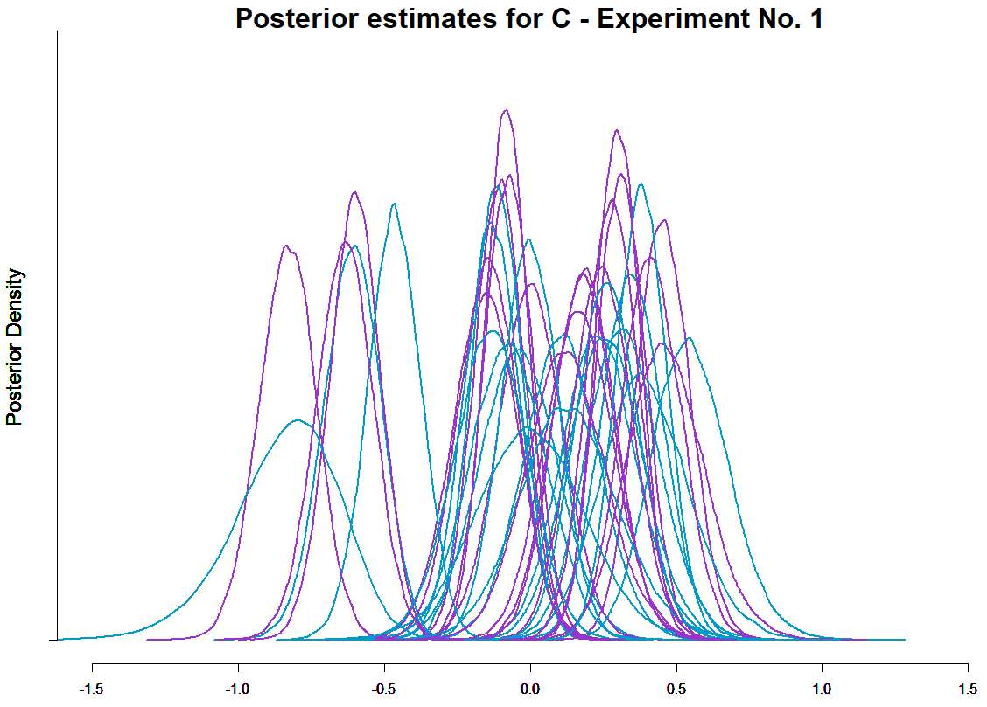

Slide 39
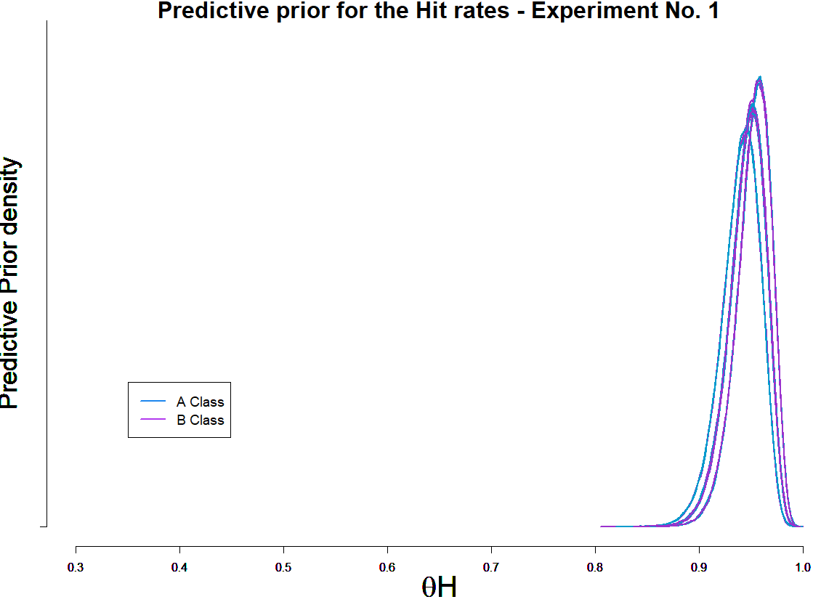
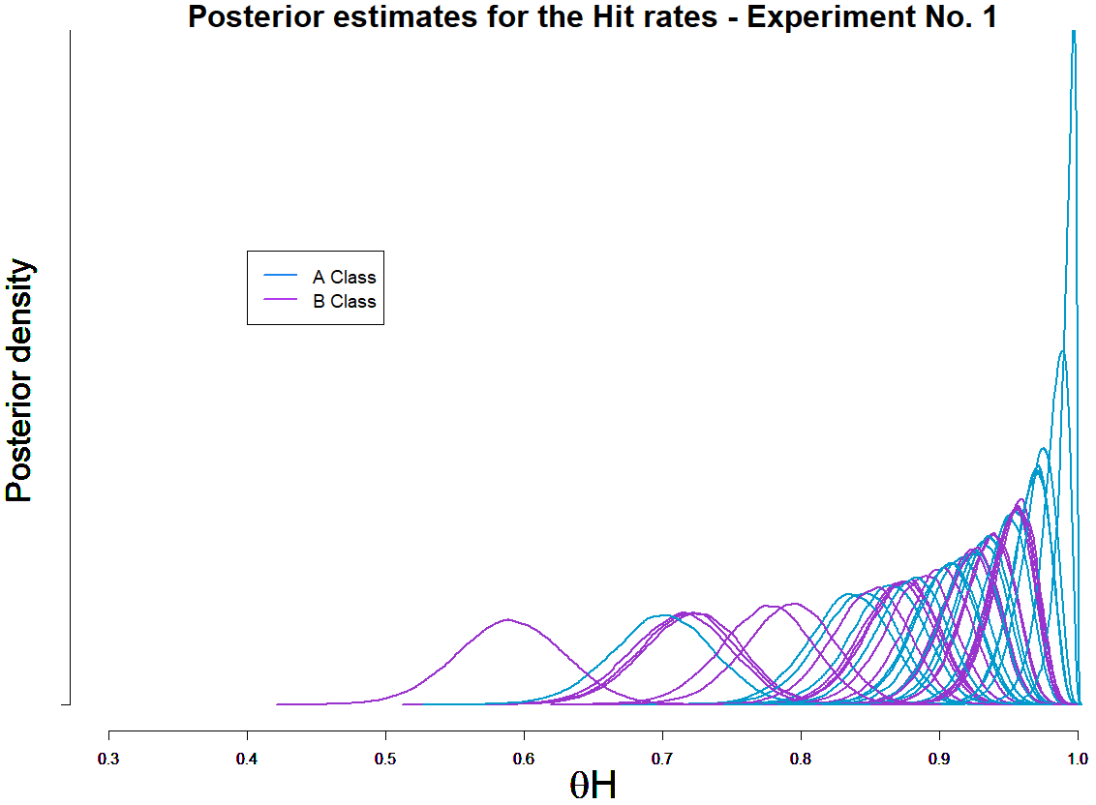

Slide 40
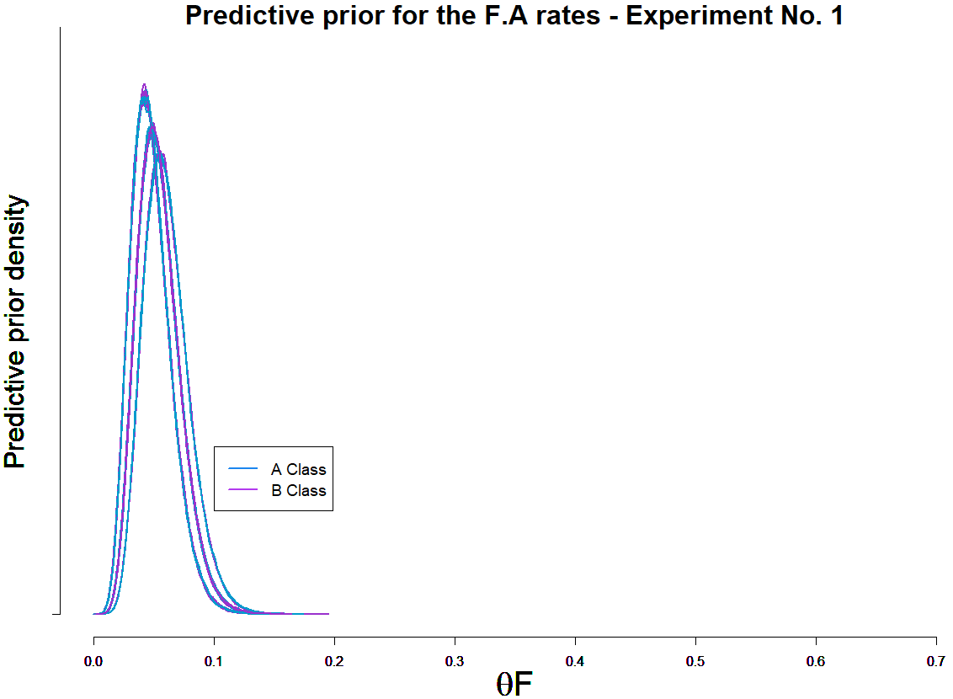
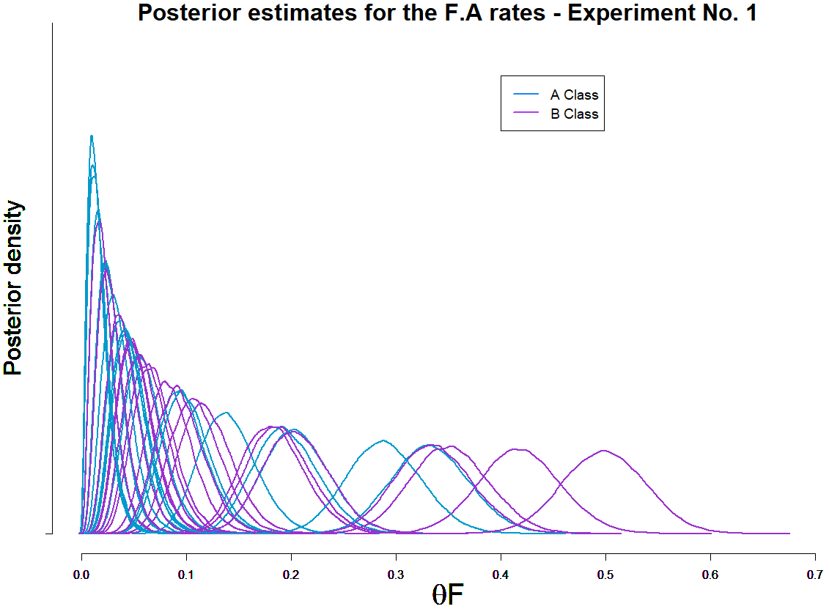

Slide 41
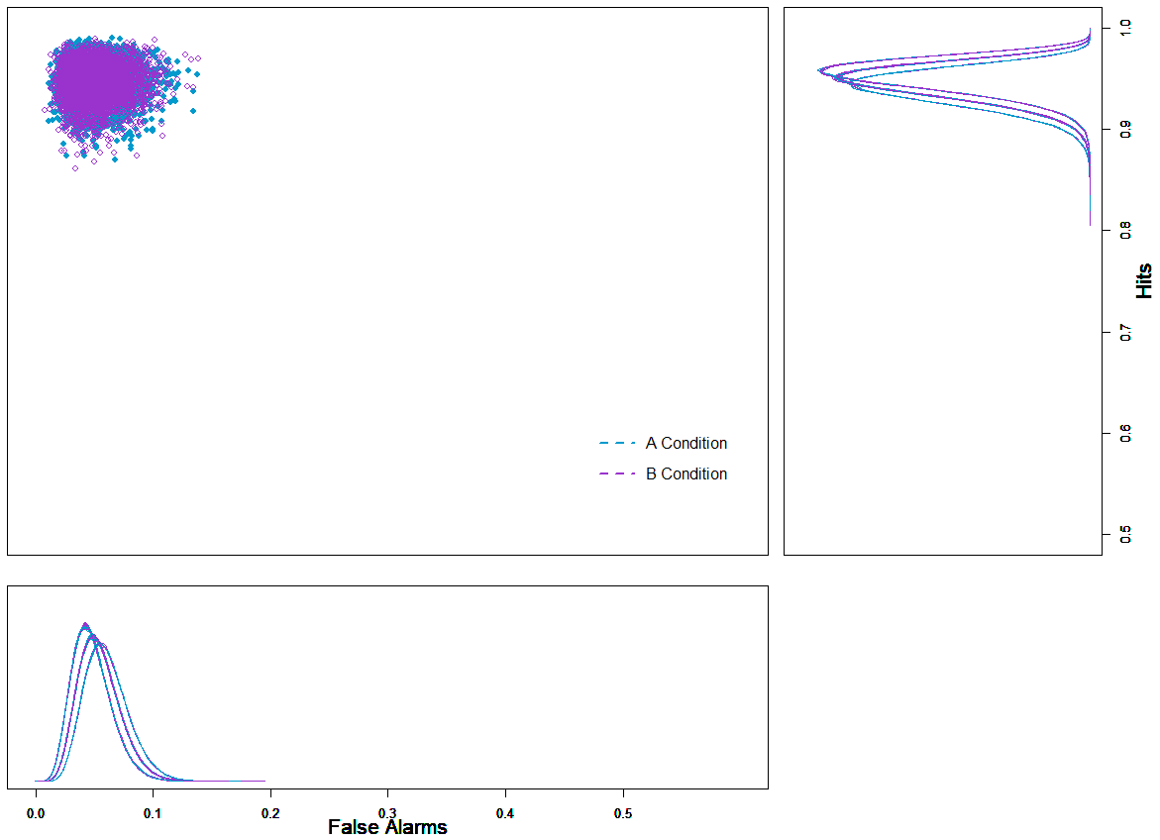
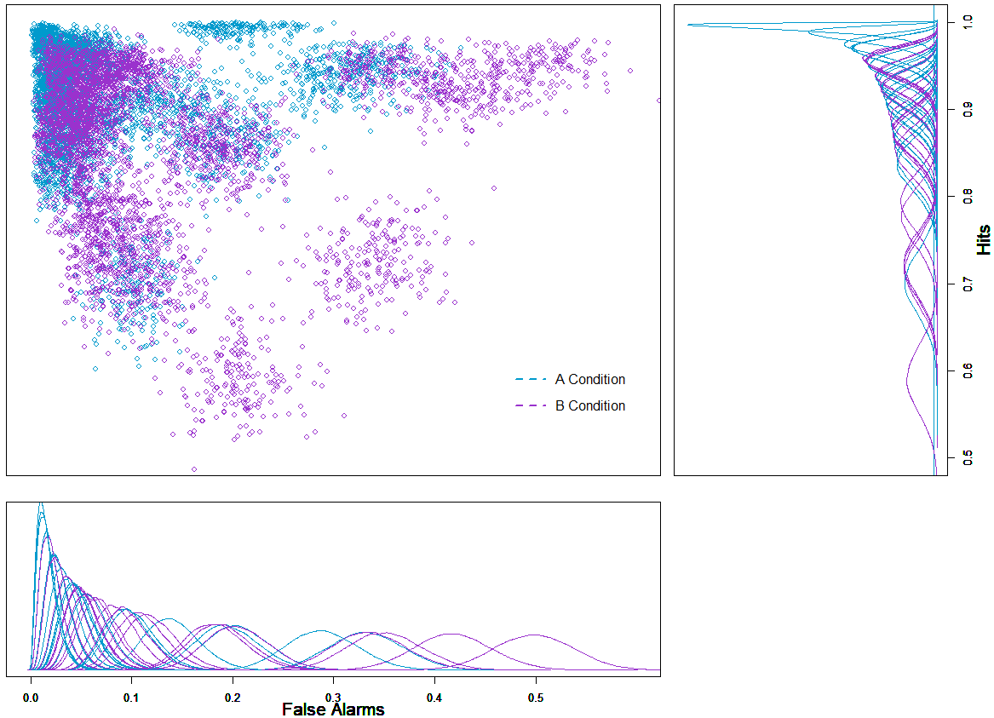
Experiment No. 1

Slide 47
3. Bayesian hierarchical cognitive modeling of our data
Ok, we already know what’s happening in terms of our d’, but, is there any good reason not to look into c estimates as well?

Slide 48
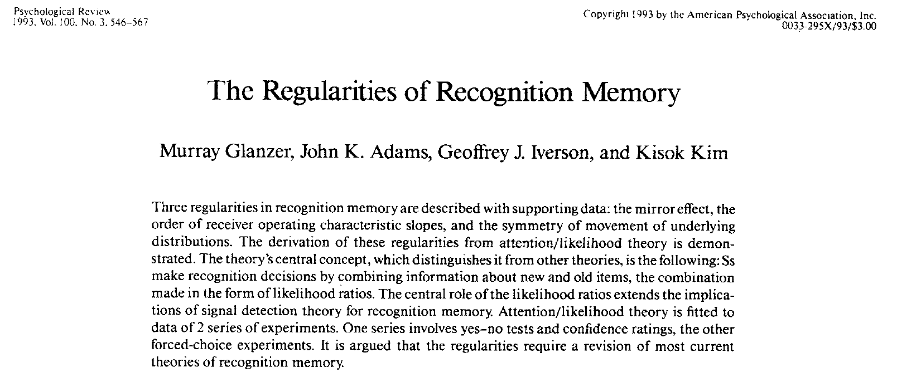
According to this article:

Slide 49
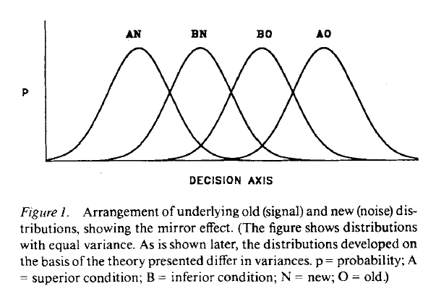
1) There’s a single criterion

Slide 50
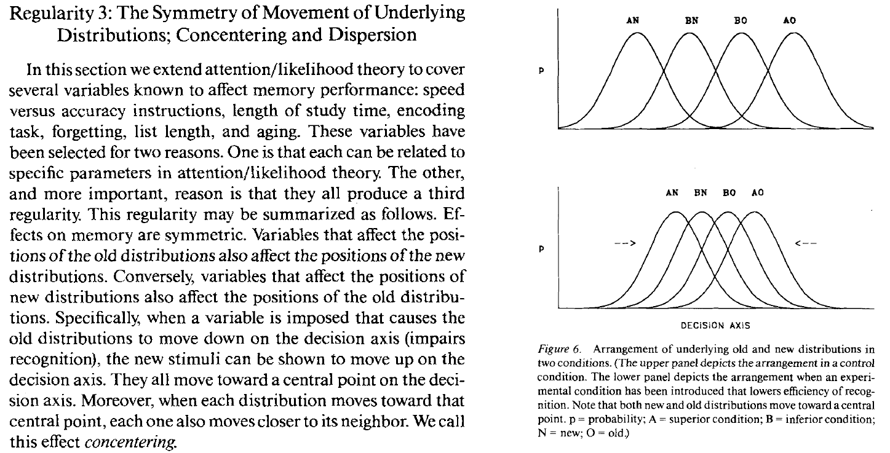
2)

Slide 51
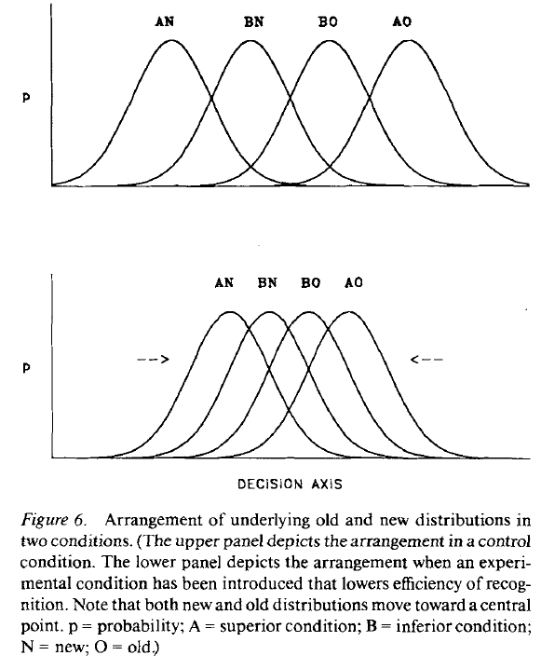
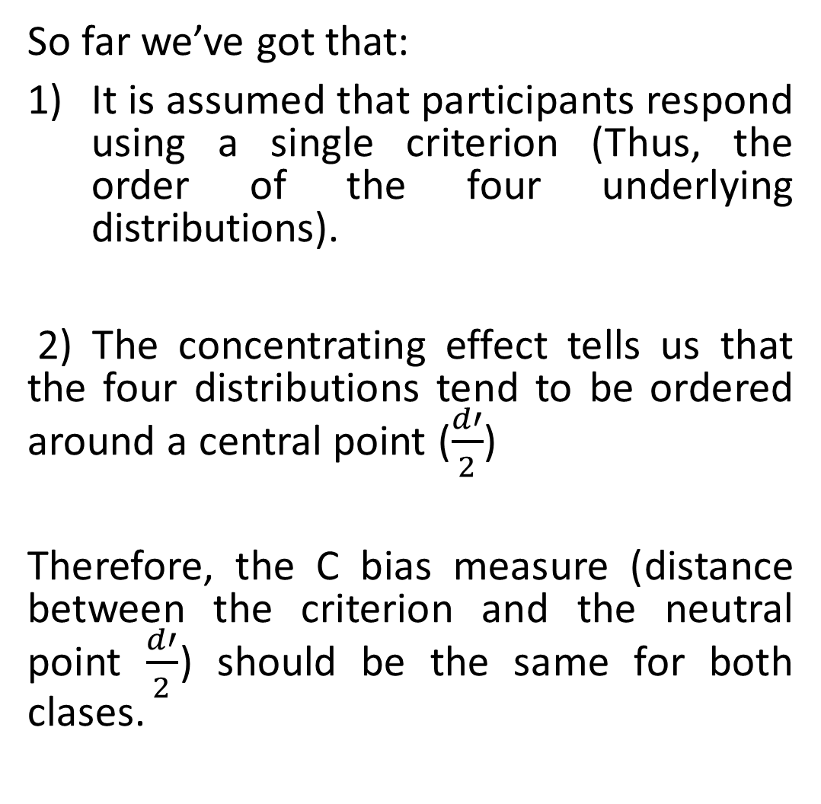
So far we’ve got that:
It is assumed that participants respond using a single criterion (Thus, the order of the four underlying distributions).
2) The concentrating effect tells us that the four distributions tend to be ordered around a central point ($\frac{d′}{2}$)
Therefore, the C bias measure (distance between the criterion and the neutral point $\frac{d′}{2}$) should be the same for both clases.

Slide 52
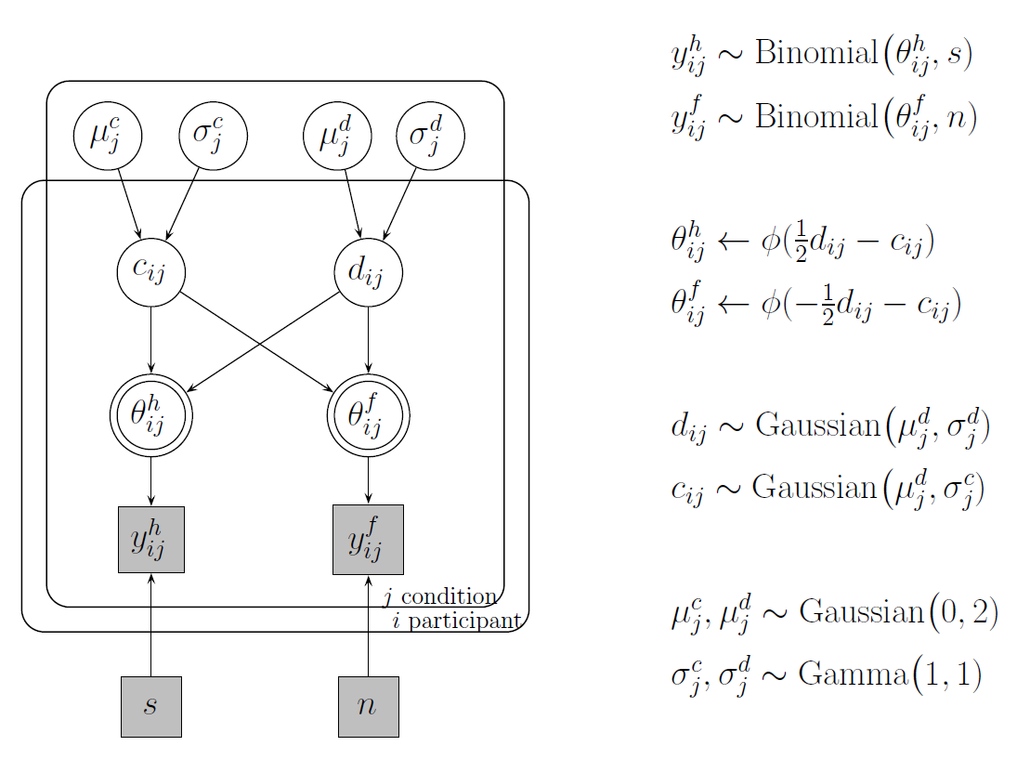
We apply a Hierarchical Bayesian SDT model

Slide 53
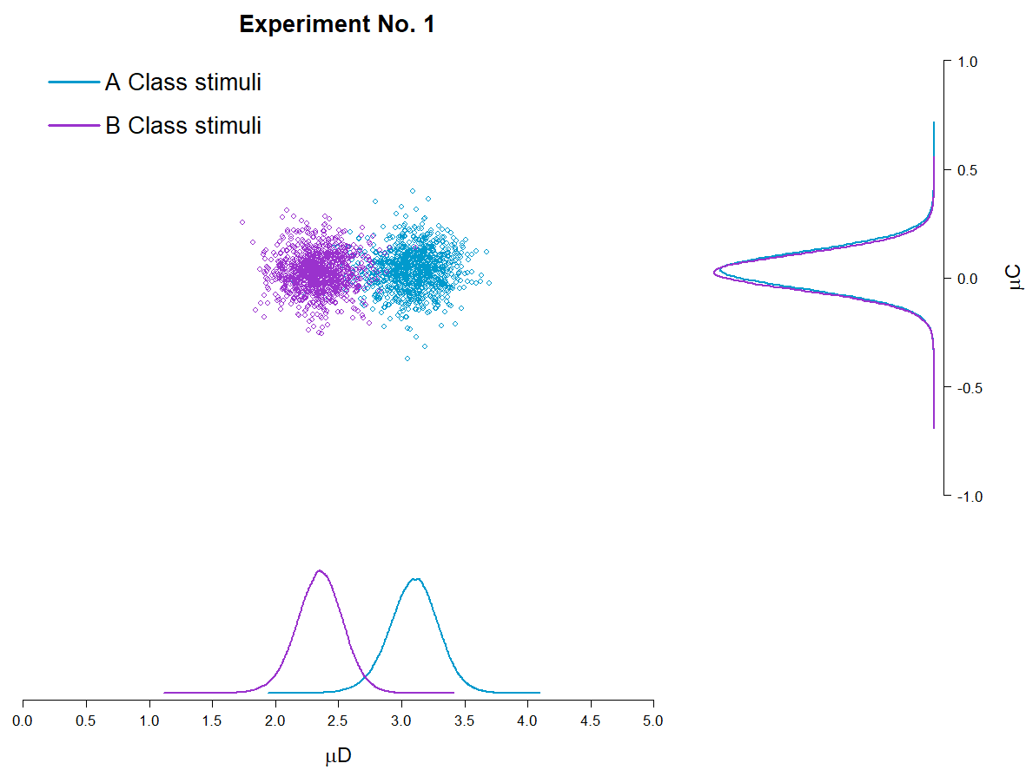
Plot 1
It is interesting to note that for Experiment No. 1, yes, some differences are found in terms of the mean d’ estimations for each class of stimuli, but this doesn’t happen for C, which according to the proposed hierarchical model could be described by the same mean value for both classes of stimuli.

Slide 54
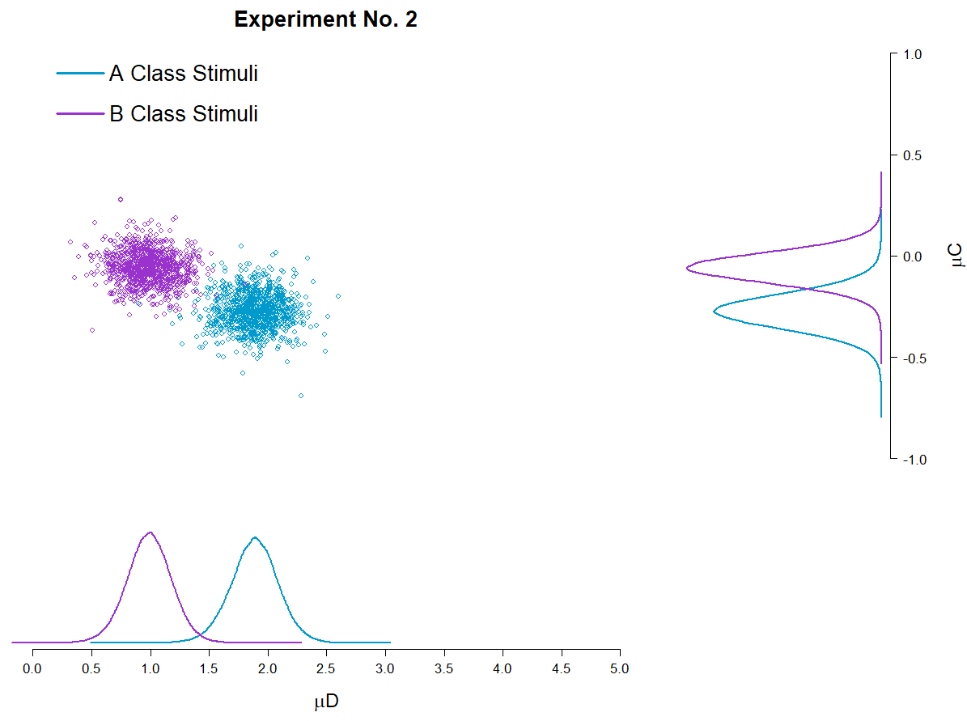
Plot 1
Even more interesting should be the fact that this doesn’t hold up for Experiment No. 2, where differences between classes of stimuli are observed both for d’ and C.

Slide 55
4. Step change point modeling
PENDING
Do participants face changes in D’ or C across trials?

Slide 56
5. Testing an Unequal Variance Model
PENDING
What can be inferred from the Confidence rating data?

Slide 57
5.1 Are participants using all of the Confidence Ratings ?
PENDING

